Slide 1
Performance
Morteza Nikooghadam
Chapter 6

Slide 2
Motivation: Why Performance?
Purchasing perspective: Given a collection of machines, which has the best performance? Best cost? Best performance/cost?
Design perspective: Faced with design options, which has the best performance improvement? Best performance/cost?
Both require
  Basis for comparison
  Metric for evaluation
Goal: understand performance implications of
architectural choices
Performance

Slide 3
Performance
Key to understanding underlying organizational motivation
  Why is some hardware better than others for different programs?
  What factors of system performance are hardware related?
    Do we need a new machine, or a new operating system?
  How does the machine's instruction set affect performance?
Outline
  Definition of performance
  CPU performance formula
  Measuring, reporting, and summarizing performance
  Common pitfalls
Performance

Slide 4
Which Has the Best Performance?
Airplane Passengers Range (mi) Speed (mph)
Boeing 777 375 4630 610
Boeing 747 470 4150 610
BAC/Sud Concorde 132 4000 1350
Douglas DC-8-50 146 8720 544
How much faster is the Concorde compared to the 747?
How much bigger is the 747 than the Douglas DC-8?
Performance

Slide 5
Two Notions of “Performance”
Plane
DC to Paris
Speed
Passengers
Throughput (pmph)
Boeing 747
6.5 hours
610 mph
470
286,700
BAD/Sud Concorde
3 hours
1350 mph
132
178,200
Which has higher performance?
  Time to deliver 1 passenger? 400 passengers?
Performance notions
  Time to do the task: execution time, response time, latency
  Task per unit time: throughput, bandwidth
  Response time and throughput often are in opposition
Performance

Slide 6
Which Is Better?
Time of Concorde vs. Boeing 747:
  Concord is 1350 mph / 610 mph
  = 2.2 times faster
  = 6.5 hours / 3 hours
Throughput of Concorde vs. Boeing 747:
  Boeing is 286,700 pmph / 178,200 pmph
  = 1.6 times better
Boeing is 1.6 times (60%) faster in terms of throughput
Concord is 2.2 times (120%) faster in terms of flying time (response time)
Performance
Notes:
We will focus on execution time for a single job

Slide 7
Computer Performance
Response time (latency)
  How long does it take for my job to run?
  How long does it take to execute a job?
  How long must I wait for the database query?
Throughput
  How many jobs can the machine run at once?
  What is the average execution rate?
  How much work is getting done?
If we upgrade a machine with a new processor what do we increase?
If we add a new machine to the lab what do we increase?
We will focus on execution time for a single job
Performance
Notes:
Have them raise their hands when
answering questions

Slide 8
Execution Time
Elapsed time
  Counts everything (disk and memory accesses, I/O , etc.)
  A useful number, but often not good for comparison purposes
CPU time
  Does not count I/O or time spent running other programs
  Can be broken up into system time, and user time
Our focus: user CPU time
  Time spent executing the lines of code that are "in" our program
Performance

Slide 9
Definition of Performance
For some program running on machine X,
Performance_{X} = 1 / Execution time_{X}
  Faster is better
"X is n times faster than Y”
Performance_{X} / Performance_{Y} = n
Example
  Machine A runs a program in 20 seconds
  Machine B runs the same program in 25 seconds
  How much faster is A than B?
    A is 25/20 =1.25 times faster than B
    A is 25% faster than B
Performance

Slide 10
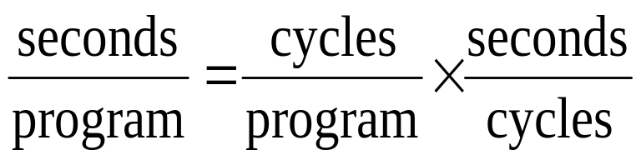
Clock Cycles
Instead of reporting execution time in seconds, we often use cycles
Clock “ticks” indicate when to start activities
  Synchronization signal for computer components
  Cycle time = time between ticks = seconds per cycle
  Clock rate (frequency) = cycles per second (1 Hz = 1 cycle/sec)
  A 4 GHz clock has a cycle time
time
Performance

Slide 11
How to Improve Performance
So, to improve performance (everything else being equal) you can either
________ the # of required cycles for a program, or
________ the clock cycle time, or, said another way,
________ the clock rate
reduce
decrease
increase
Performance

Slide 12
How Many Cycles for a Program?
Could assume that # of cycles = # of instructions
1st instruction
3rd instruction
2nd instruction
4th
5th
6th
...
time
This assumption is incorrect: different instructions take different amounts of time on different machines
Why? Remember that these are machine instructions, not lines of C code
Performance

Slide 13
Number of Cycles for Instructions
time
Multiplication takes more time than addition
Floating point operations take longer than integer ones
Accessing memory takes more time than accessing registers
Important point: changing the cycle time often changes the number of cycles required for various instructions (more later)
Performance

Slide 14
Example
Computer A: 400MHz, our favorite program runs for 10 seconds on computer A
We are trying to help a computer designer build a new machine B, that will complete this program in 6 seconds
  The designer can use new (or perhaps more expensive) technology to substantially increase the clock rate, but this increase will affect the rest of the CPU design, causing machine B to require 1.2 times as many clock cycles as machine A for the same program
  What clock rate should we tell the designer to target?
Performance

Slide 15
Example
Let C = number of cycles
  Execution time = C × clock cycle time = C/ clock rate
On computer A
  C/ 400 MHz = C/ (400 × 10⁶)= 10 seconds
  => C = 400 × 10⁷
On computer B, number of cycles = 1.2 × C
What should be B’s clock rate so that our favorite program has smaller execution time or 6 seconds?
  1.2 × C/ clock rate < 10 => 1.2 × 400 × 10⁷ / 10 < clock rate, i.e. clock rate > 480 MHz
  1.2 × C/ clock rate = 6 => 1.2 × 400 × 10⁷ / 6 = clock rate, i.e. clock rate = 800 MHz
Performance

Slide 16
Now That We Understand Cycles
A given program will require
  Some number of instructions (machine instructions)
  Some number of cycles
  Some number of seconds
We have a vocabulary that relates these quantities:
  Cycle time (seconds per cycle)
  Clock rate (cycles per second)
  CPI (cycles per instruction)
    Average CPI of a program depends on the instruction mix of the program
    A floating point intensive application might have a higher CPI
Performance

Slide 17
CPI = Average Cycles/Instruction
Consider a program with 5 instructions
Instruction | #cycles
1 | 2
2 | 2
3 | 4
4 | 2
5 | 1
Total | 11
CPI | 11/5 = 2.2
Another way of saying it is 11 = 5 × 2.2
OR CPU cycles = #instructions × CPI
Performance

Slide 18
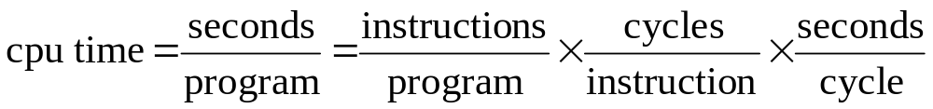
Program Performance
Measuring the components of CPU time for a given program
  Instruction count
    Profiler or simulator
  CPI
    Depends on hardware implementation AND the given program’s instruction mix
  Clock rate
    Published
Performance

Slide 19
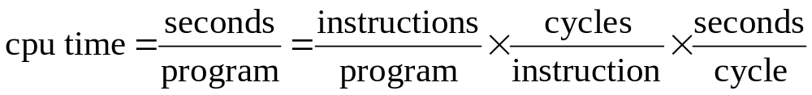
Aspects of CPU Performance
 | Instruction Count | CPI | Clock cycle time
Algorithm | X | X
PL | X | X
Compiler | X | X
Instruction Set | X | X
Organization |  | X | X
Technology |  |  | X
Performance

Slide 20
Performance
Performance is determined by execution time
Do any of the other variables equal performance?
  # of cycles to execute program?
  # of instructions in program?
  # of cycles per second?
  Average # of cycles per instruction?
  Average # of instructions per second?
Common pitfall: thinking one of the variables is indicative of performance when it really isn’t
Performance

Slide 21
CPI Example
Suppose we have two implementations of the same instruction set
For a given program (instruction sequence)
  Machine A has a clock cycle time of 10 ns. and a CPI of 2.0
  Machine B has a clock cycle time of 20 ns. and a CPI of 1.2
Questions
  Which machine is faster for this program, and by how much?
Performance
Notes:
If two machines have the same ISA, which of our quantities (clock rate, CPI, execution time, # of instructions) will always be identical?

Slide 22
CPI Example
CPU time = IC × CPI × Clock cycle time
For machine A
CPU time = IC × 2.0 × 10 ns = 20 IC ns
For machine B
CPU time = IC × 1.2 × 20 ns = 24 IC ns
Performance

Slide 23
Number of Instructions Example
Classes of instructions provided by HW:
  Class: A B C
  Cycles: 1 2 3
A compiler designer is trying to decide between two code sequences for this machine
  The first code sequence has 5 instructions: 2 of A, 1 of B, and 2 of C
  The second sequence has 6 instructions: 4 of A, 1 of B, and 1 of C
Which sequence will be faster? How much?
What is the CPI for each sequence?
Performance
Notes:
Based on the hardware implementation, there are three different classes of instructions: Class A, Class B, and Class C, and they require one, two, and three cycles (respectively)

Slide 24
Number of Instructions Example
Classes of instructions provided by HW:
  Class: A B C
  Cycles: 1 2 3
Two sequences to compare
  The first code sequence has 5 instructions: 2 of A, 1 of B, and 2 of C
  The second sequence has 6 instructions: 4 of A, 1 of B, and 1 of C
Which one is faster?
  We should compare CPU time (cycles)
  Sequence I: 2×1+ 1×2+ 2×3 = 10 (cycles)
    CPI = 10/5 = 2 (cycle per instruction)
  Sequence II: 4×1+ 1×2+ 1×3 = 9 (cycles)
    CPI = 9/6 = 1.5 (cycle per instruction)
Performance

Slide 25
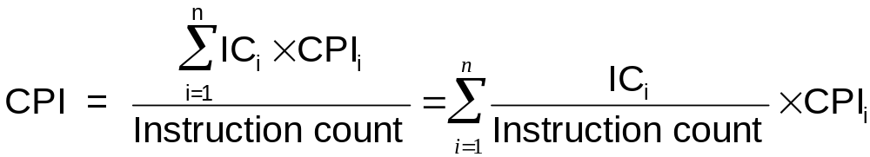
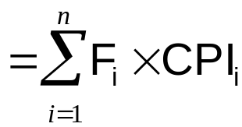

Calculating CPI in Another Way
First calculate CPI for each individual instruction (add, sub, and, etc.) or individual instruction class (integer, FP, branch, etc.)
Next calculate frequency of each individual instruction in the workload
Finally multiply these two for each instruction and add them up to get the final CPI
“instruction frequency”
Performance

Slide 26
Example Revisited
Classes of instructions provided by HW:
  Class: A B C
  Cycles: 1 2 3
  These are CPIs of individual instruction classes
CPI for a sequence with 5 instructions: 2 of A, 1 of B, and 2 of C
  Instruction frequencies: F_{A}=F_{C}=2/5 = 0.4, F_{B}=1/5= 0.2
  Overall CPI = 0.4×1 + 0.2×2 +0.4×3
  = 0.4+ 0.4 + 1.2 = 2
Performance

Slide 27
Outline
Definition of performance
CPU performance formula
Measuring, reporting, and summarizing performance
Fallacies and pitfalls
Performance

Slide 28
Performance: Benchmarks
To evaluate system performance, we need to measure the execution time for representative workloads
  Real applications
  Benchmarks
    Discredited examples: kernels, toy programs, synthetic benchmarks
Benchmark suite: a collection of varied applications to fairly compare processors
  Not to “place too many eggs in one basket”
  Often also specify running conditions
    Compilers and flags
Performance

Slide 29
Choosing Benchmark Programs
Pros
Cons
Very specific
Non-portable
Difficult to run, or
measure
Hard to identify cause
Representative
Actual Target Workload
Portable
Widely used
Improvements useful in reality
Less representative
Full Application Benchmarks
Easy to run, early in design cycle
Small “Kernel”
Benchmarks
Easy to “fool”
Identify peak capability and potential bottlenecks
“Peak” may be a long way from application performance
Micro benchmarks
Performance

Slide 30
Benchmark Suite
SPECCPU: popular desktop benchmark suite
  SPECint2006 has 12 integer program, SPECfp2006 has 17 floating-point programs
SPECSFS (NFS file server) and SPECWeb (WebServer) serve server benchmarks
Transaction Processing Council measures server performance/availability and cost-performance for databases
  TPC-C: complex query for online transaction processing
  TPC-H: ad hoc decision support
  TPC-W: a transactional web benchmark
  TPC-App: application server and web services
Performance
Notes:
Spec 06: 5th generation
TPC: auditor, some human-being must watch you to generate that result and sign, TPC original jim gray

Slide 31
SPEC
Standard Performance Evaluation Corporation
Benchmarks distributed in source code
Members of consortium select workload
  30+ companies, 40+ universities
New release every few years
  SPEC89, SPEC92, SPEC95, SPEC00, SPEC06
Web site: www.spec.org
Performance

Slide 32
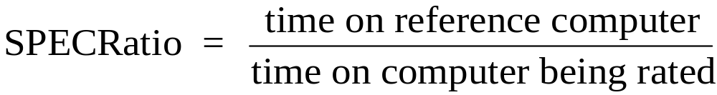
Performance Comparison
Fair comparison
  Same workload
    Specified inputs
  Same running environment
    Compiler version/flag
SPECRatio: normalize execution times to a reference computer, yielding a performance metric:
  Useful in summarizing performance for a suite of multiple benchmarks
Performance

Slide 33
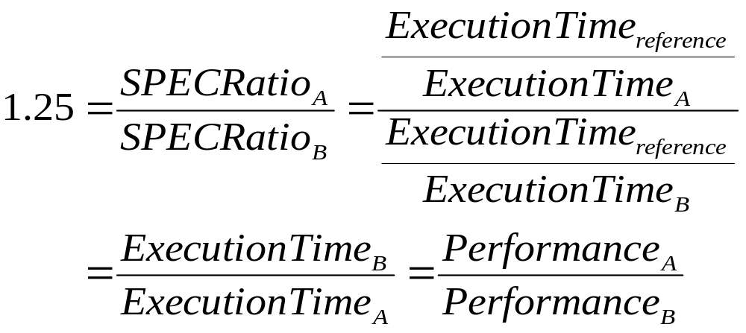
Performance Comparison
If program SPECRatio on Computer A is 1.25 times bigger than Computer B, then
  Choice of reference computer is irrelevant
Performance
Notes:
Note that when comparing 2 computers as a ratio, execution times on the reference computer drop out, so choice of reference computer is irrelevant

Slide 34
Summarize Suite Performance
Example
Arithmetic average
  Machine X: 1001/2=500.5, machine Y: 110/2=55
  500.5/55 = 9.1x
  Only valid if programs run equally often
    Program 2 determines the result
Weighted arithmetic average
  How to choose the weights?
Benchmark | Machine X | Machine Y
Program 1 | 1 | 100
Program 2 | 1000 | 10
Total | 1001 | 110
Performance
Notes:
Maximize their own benefit

Slide 35
Reporting Performance
Guiding principle: reproducible
  List everything another experimenter would need to duplicate the results (especially, the input set)
  Fig. 4.3
Hardware
CPU 3.2-GHz Pentium 4 Extreme Edition
L3 Cache size 2048KB (I+D) on chip
Memory 4 x 512 MB
Disk subsystem 1 x 80GB ATA/100 7200RPM
Software
OS Windows XP Professional SP1
Compiler Intel C++ Compiler 7.1
Performance

Slide 36
Two SPEC Benchmarks
Compare the performance of recent Intel processors
Performance with SPEC CPU Benchmarks
  CINT2000
  CFP2000
  Each SPEC ratio is a ratio of execution time
    SPEC ratio(A,go) = time (Sun Ultra 5_10 ,go) / time(A,go)
SPECweb99
  A throughput benchmark for web servers
Performance

Slide 37
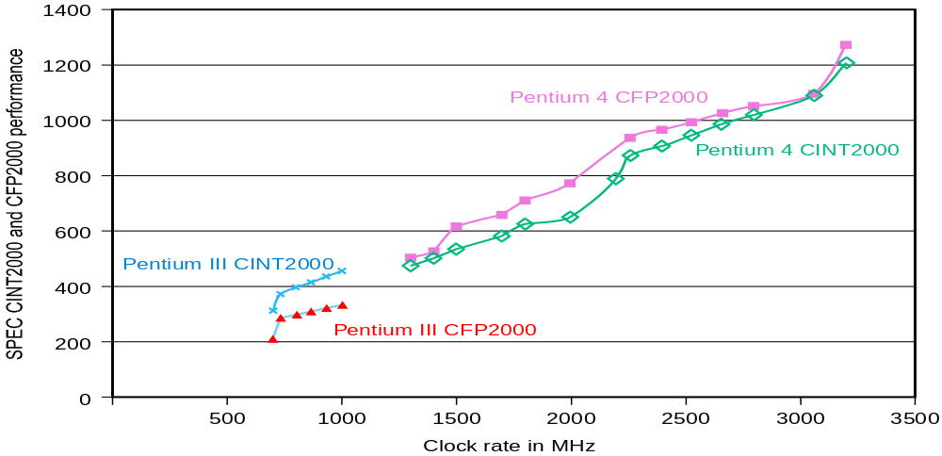
Performance Comparison
SPEC CINT2000 and CFP2000 Rating for Pentium III and Pentium 4 at different clock rates
Fig. 4.6
Performance
Notes:
1.Performance scales with the clock frequency. Not the usual case. Losses in memory system is not presented.
2. Pentium III performs better for CINT2000 than for CFP2000. Pentium 4 is reverse.

Slide 38
Outline
Definition of performance
CPU performance formula
Measuring, reporting, and summarizing performance
Fallacies and pitfalls
Performance

Slide 39
Pitfall I
Pitfall: expecting too high on the improvement of one aspect of a computer
  Performance improvement effect depends on how applicable is the improvement
Focus the common case: in making a design trade-off, favor the frequent case over the infrequent case
  E.g., optimize instruction fetch and decode unit before multiplier
  E.g., if database server has 50 disks / processor, storage dependability dominates system dependability, so optimize it first
A quantitative description: Amdahl’s Law
Performance

Slide 40
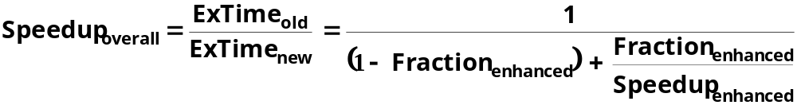

Amdahl’s Law
Best you could ever hope to do:
Performance

Slide 41
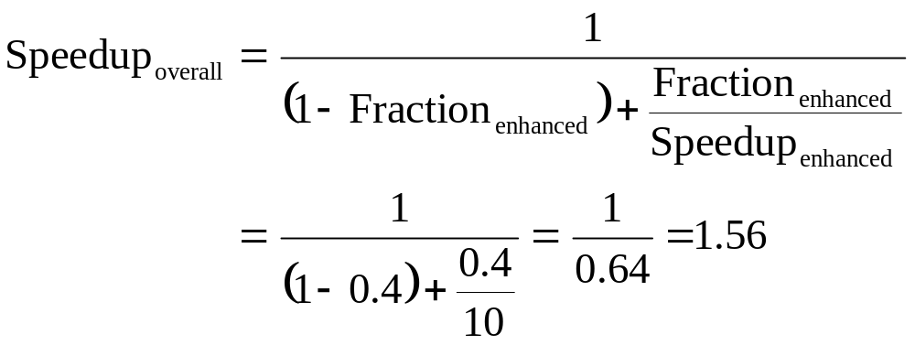
Amdahl’s Law Example
Two computers
  New CPU 10X faster
  I/O bound server, so 60% time waiting for I/O
  Apparently, it’s human nature to be attracted by 10X faster, vs. keeping in perspective it’s just 1.6X faster
Performance

Slide 42
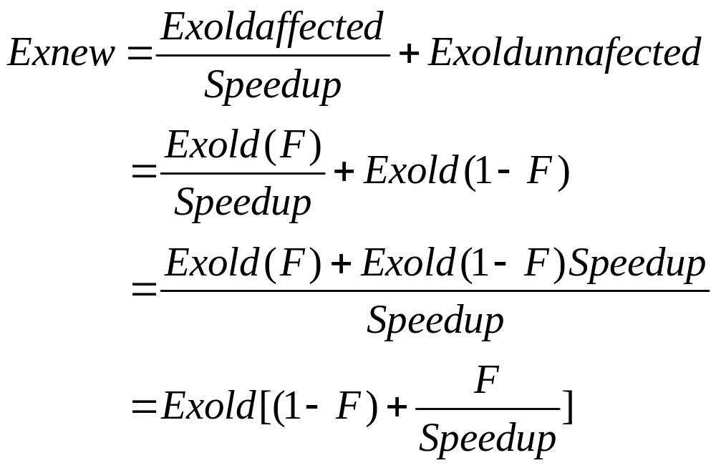
Where does the formula come from?
Performance

Slide 43
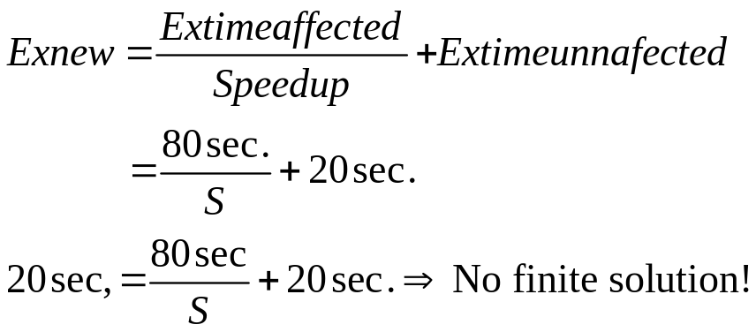
Another example
A program runs in 100s on a computer, with multiplication operations counting for 80 sec. How much do I have to improve the multiplication speed to run 5 times faster?
Answer:
Performance

Slide 44
Pitfall II
Pitfall: using a subset of the performance equation as a performance metric
  The most important metric is execution time
One alternative metric is MIPS (million instructions per second)
  MIPS = Instruction count / (Execution time×10⁶)
  Specifies performance inversely to execution time
Three problems using MIPS as a measure for comparing computers
  Cannot compare computers with different ISAs
  MIPS varies between programs on the same computer
  MIPS can vary inversely with performance!
Performance

Slide 45
MIPS Example
A 100 MHz. machine with three different classes of instructions: Class A, Class B, and Class C, which require one, two, and three cycles respectively
Two compilers are used to produce code for a large piece of software
  Compiler I: 5 million Class A instructions, 1 million Class B instructions, and 1 million Class C instructions
  Compiler II: 10 million Class A instructions, 1 million Class B instructions, and 1 million Class C instructions
Which compiler will be faster according to MIPS?
Which compiler will be faster according to execution time?
Performance

Slide 46
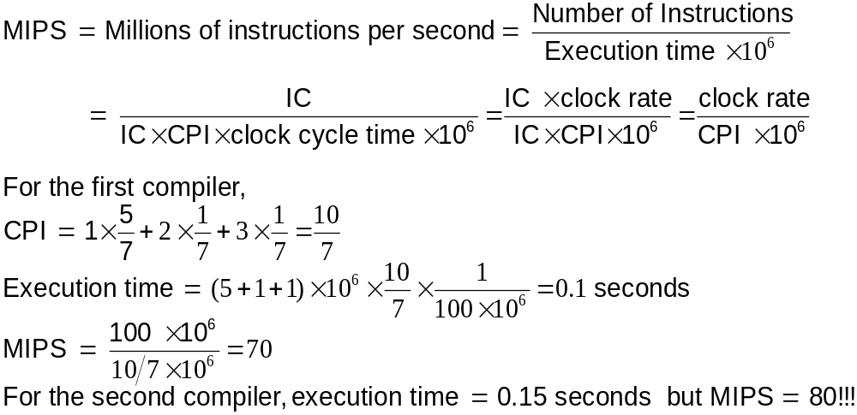
MIPS Example
Class: A B C
Cycles: 1 2 3
Compiler I: 5million 1million 1million
Compiler II: 10million 1million 1million
Performance

Slide 47
Summary
Definition of performance
CPU performance formula
  CPU time=IC×CPI×clock cycle time
Measuring, reporting, and summarizing performance
  Benchmark suite design and report
Fallacies and pitfalls
  Amdahl’s law
  MIPS
Performance

